Slide 1



EQ-sol
As the name suggests:
“Solving an Equation”
BATCH #5

Slide 2





MEET OUR TEAM!
Karun Krishnan
Omkar R
Akshay T.A
Adhithya T

Slide 3
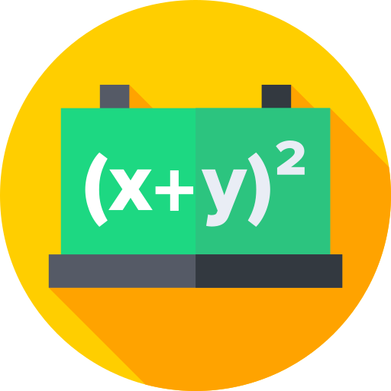
WHAT’S OUR PROJECT?
EQ-sol is an application where the user scans handwritten mathematical equations, and the corresponding solutions are displayed by the application.
Some of the features include:
Linear equations
Quadratic equations
And more

Slide 4
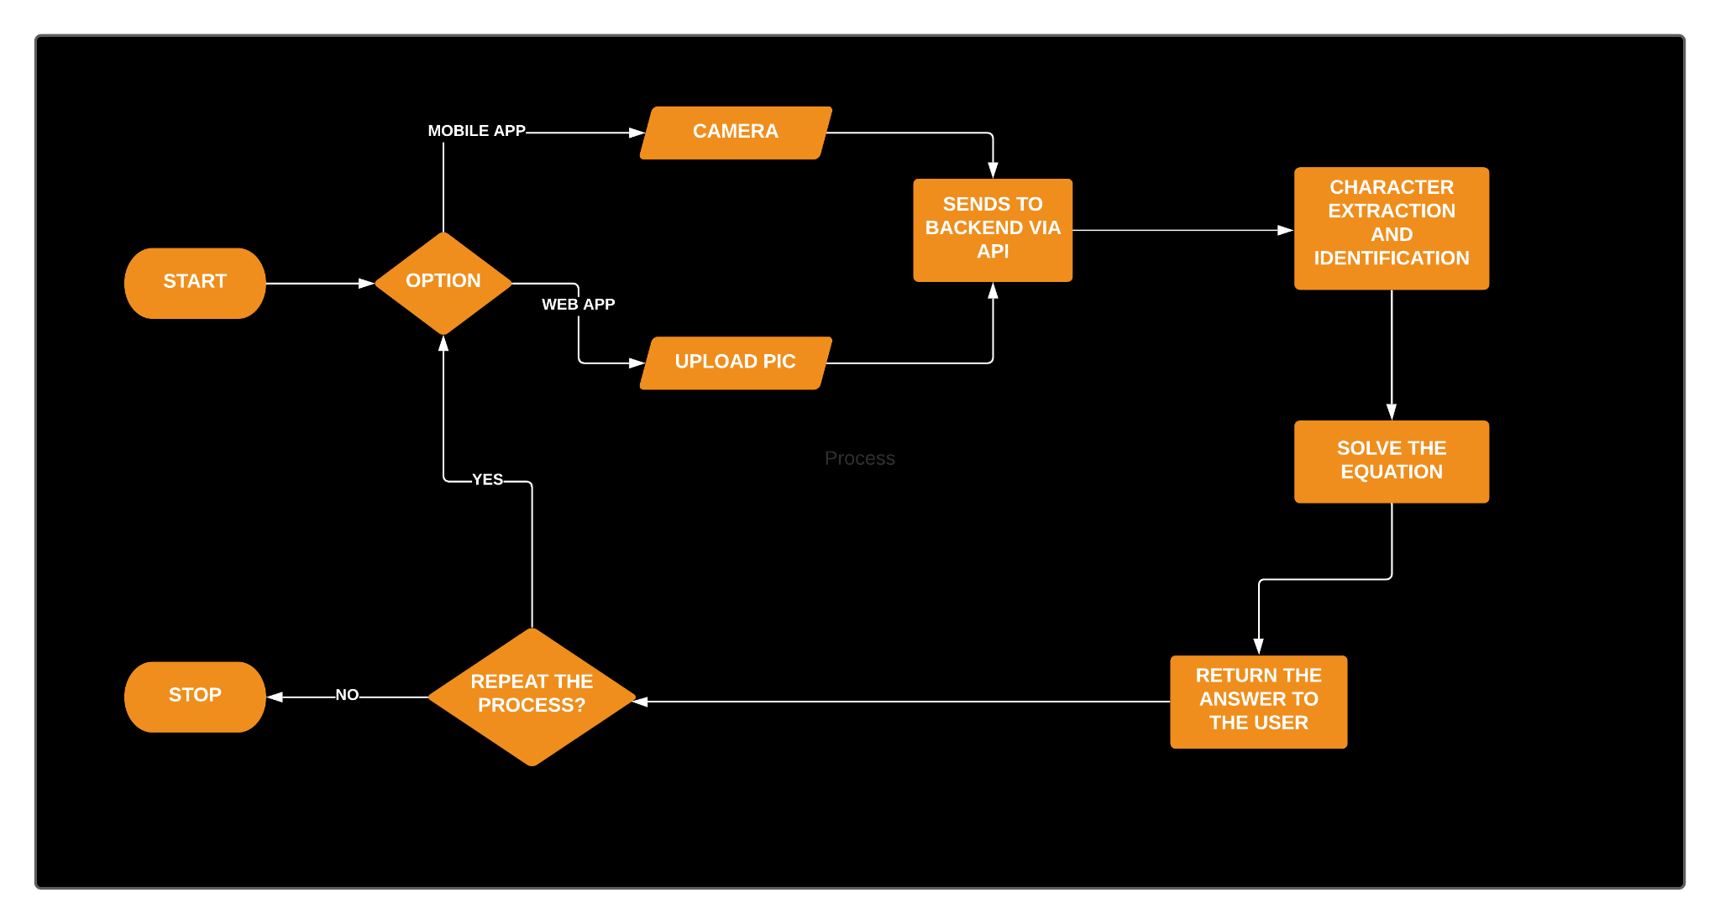
UML Diagram (LucidChart)

Slide 5
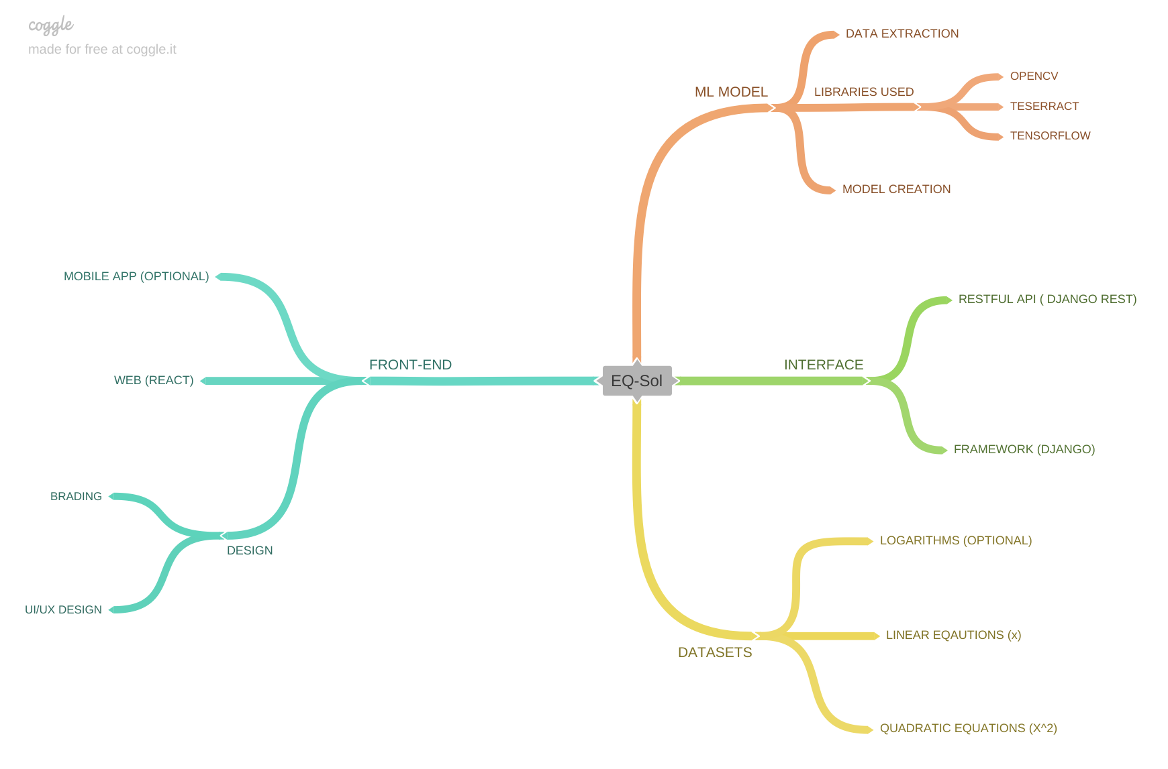
PROJECT MIND MAP (Coggle)
Click Here for the mind map

Slide 6
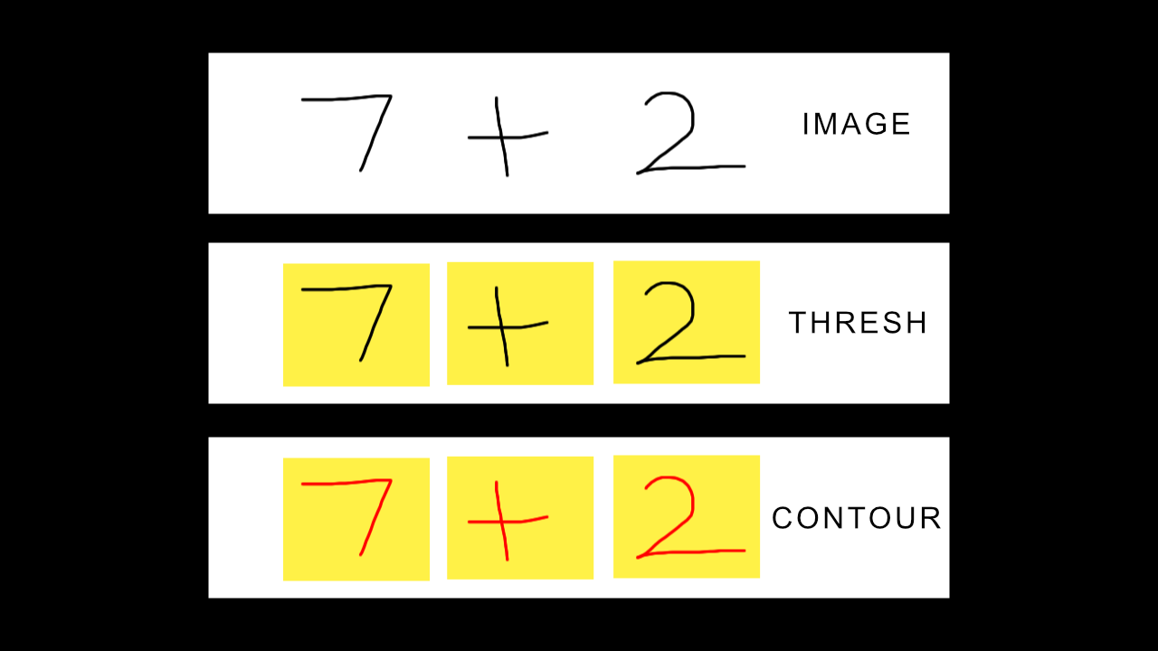

Slide 7
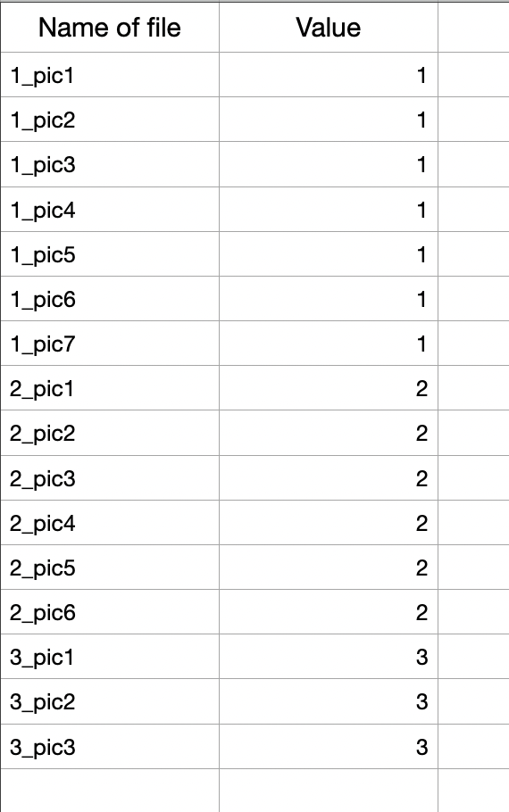
Where, ‘Name of file’ corresponds to the filename of the image and ‘Value’ corresponds to the number inside the image
This is stored as a CSV file and is used for training the model

Slide 8
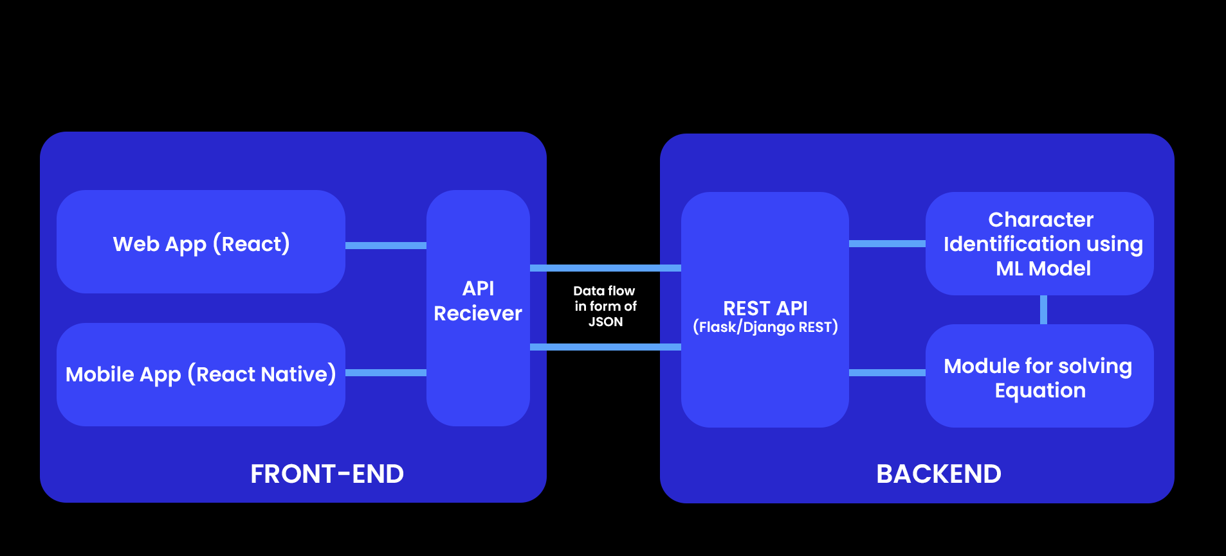
PROJECT BLOCK DIAGRAM

Slide 9
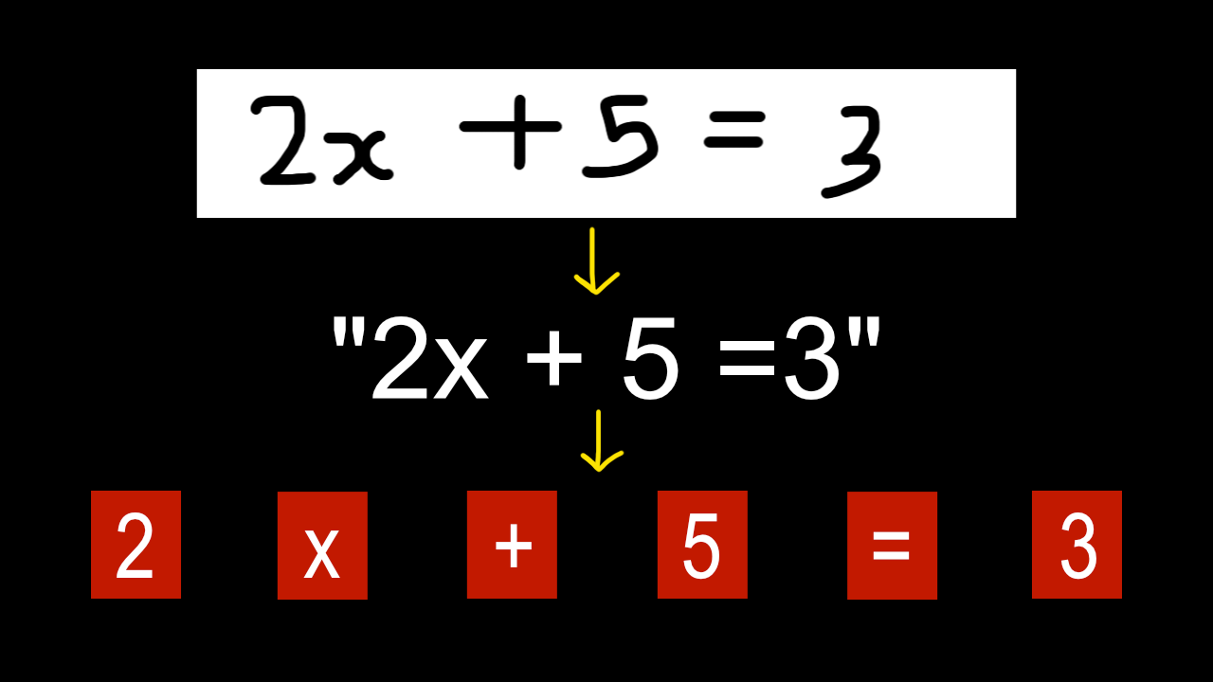

Slide 10
DIVISION OF WORK
Front-End Development, Designing and Documentation
Omkar R
Creating and Managing Datasets for the Model
Adhithya T

Slide 11
HOW WE DIVIDED OUR WORK?
Backend Development, ML Model
Karun Krishnan
Backend Development, ML Model, API Handling
Akshay T.A

Slide 12

THANK YOU

